Slide 1
L4/5 GROUP 2
Jordan Marks
Alice Baker
Thomas Gibbs
Daniel Pokladek

Slide 2
The brief
Physics based game
Easy to learn game yet hard to master

Slide 3
Logline and target audience
Logline – Beat your Foes in this gravity based planetary arena.
Target audience - 18-35 Male and Female
Platform – Mobile

Slide 4
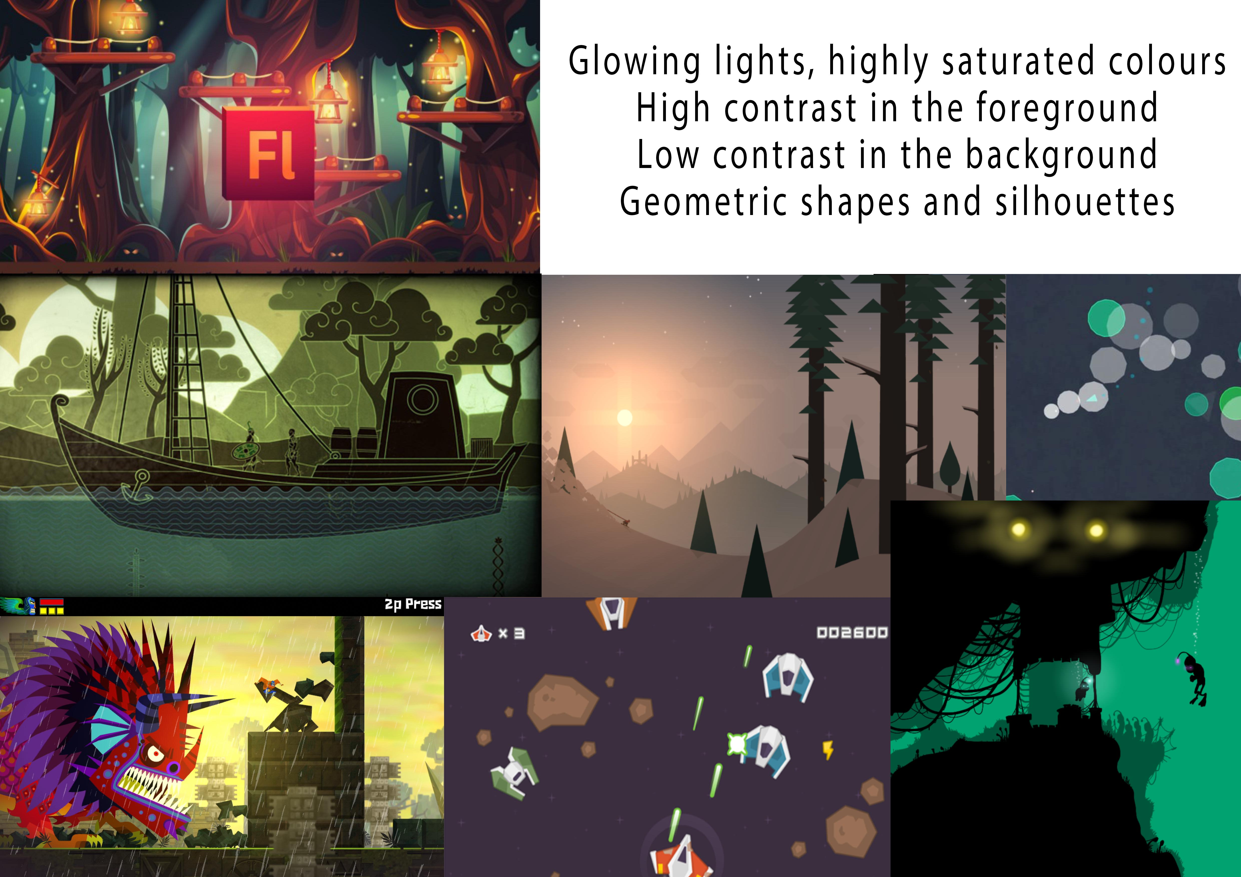

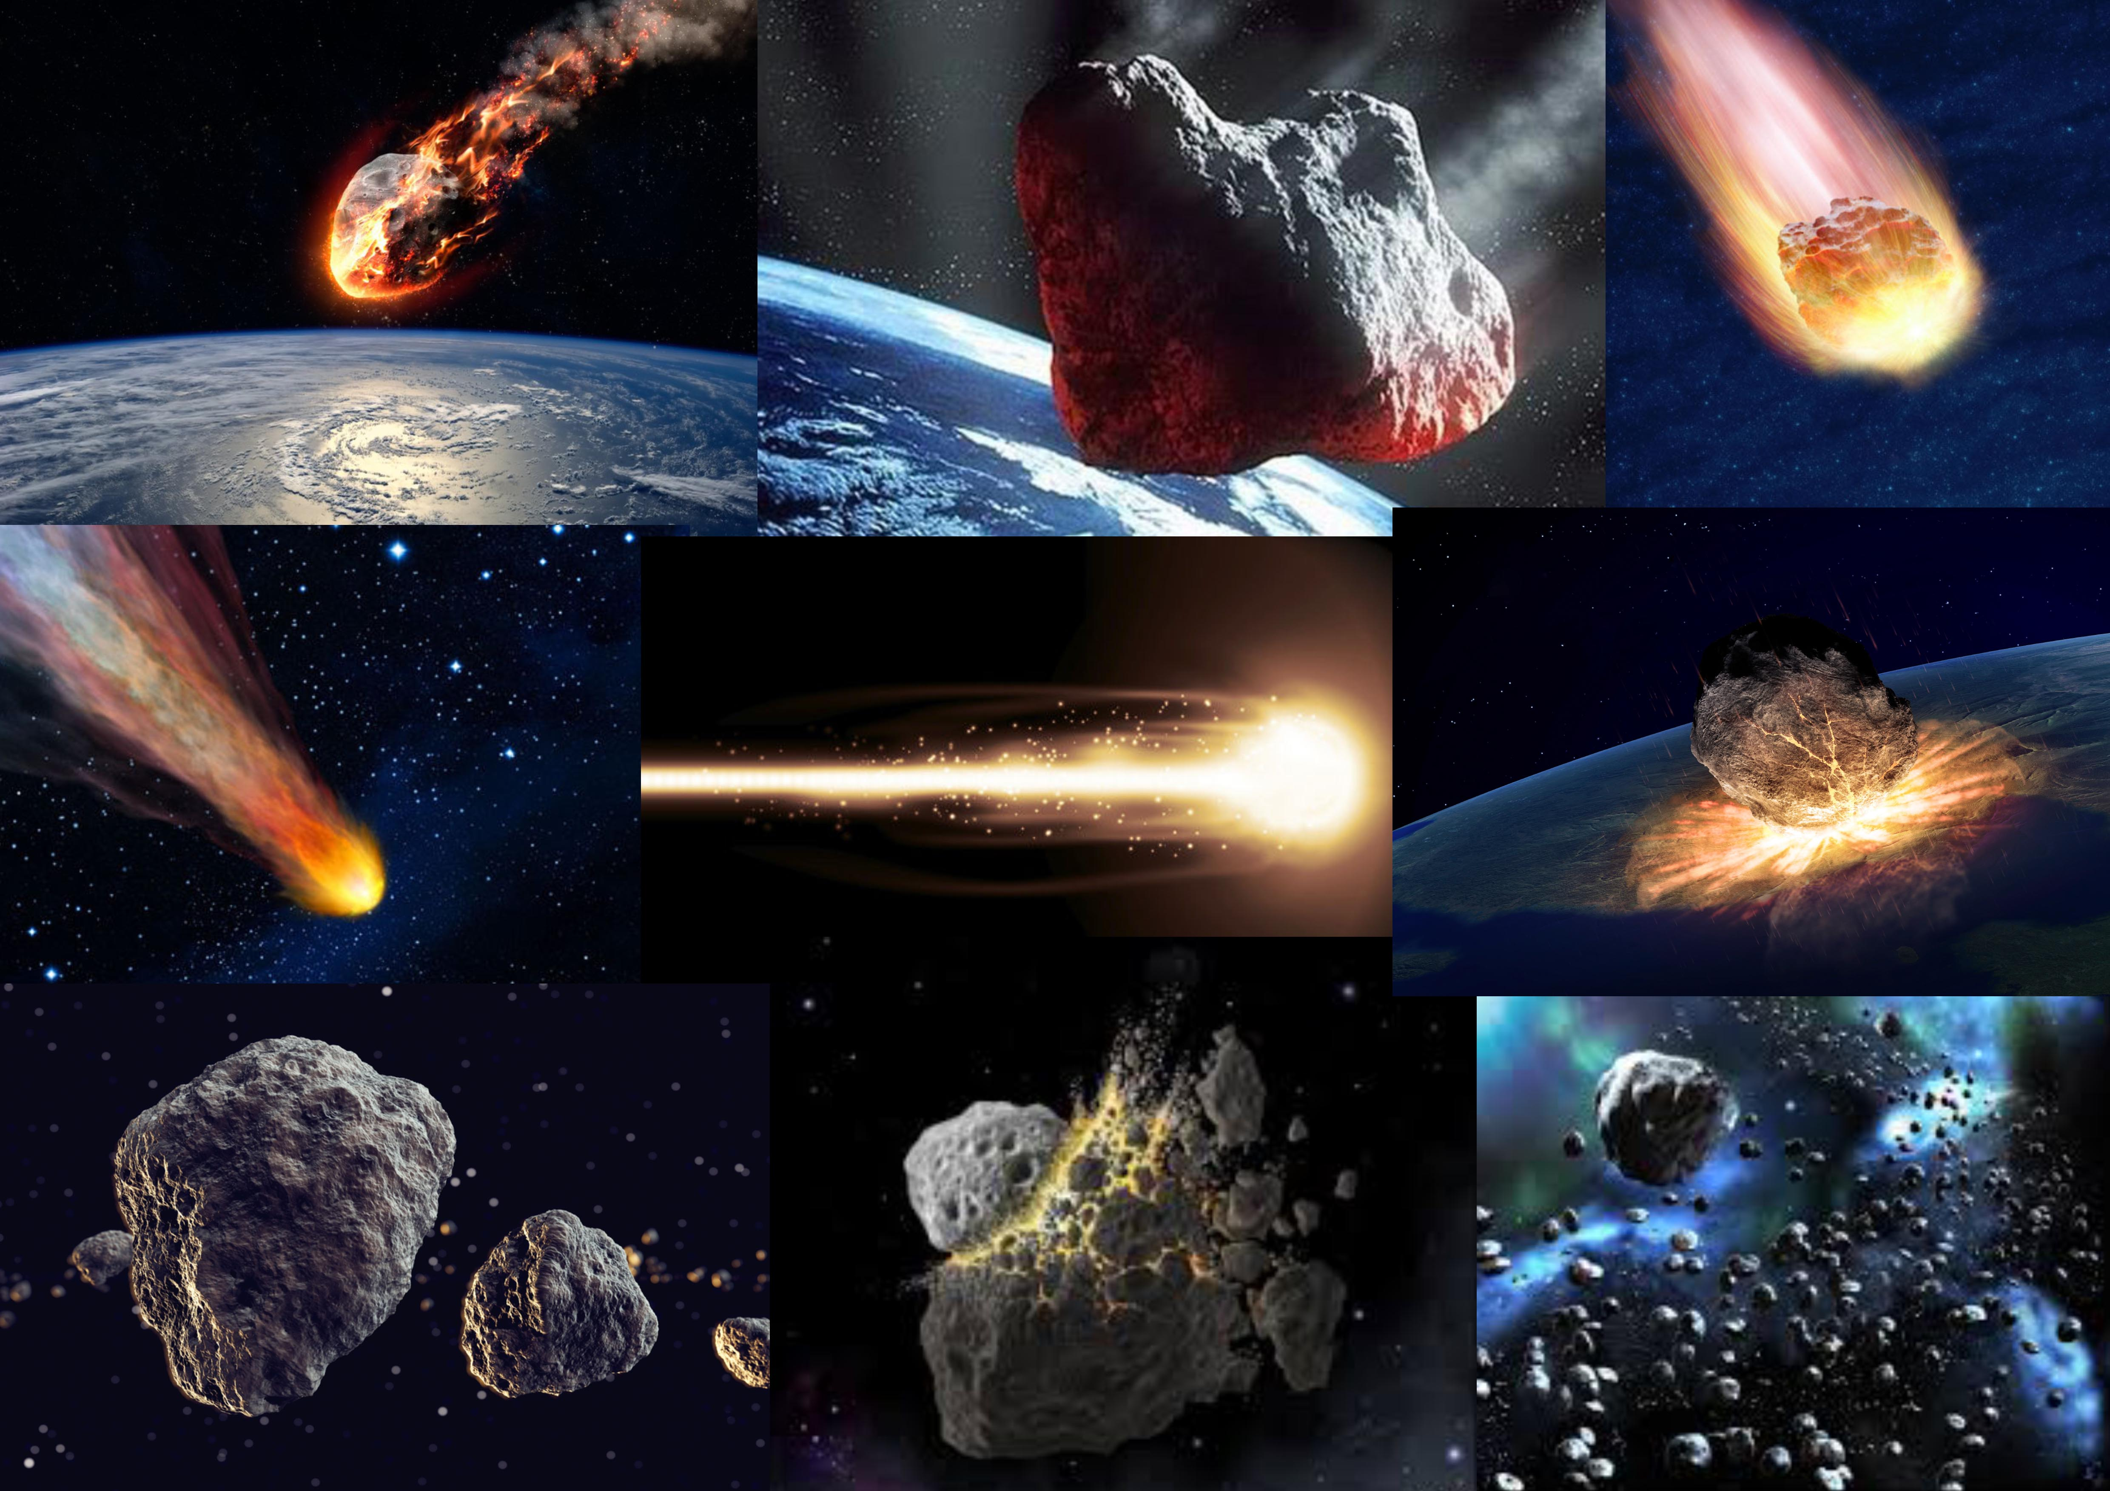

Art style and Moodboard

Slide 5
Game

Slide 6
UI

Slide 7
Prototype

Slide 8
Management emails

Slide 9
Management Work hour

Slide 10
Questions?

